Slide 1





NextGen Simulation Development Tools: ngen-datastream
Lynker: Jordan laser, Zach wills, Mike Johnson, Justin Singh-Mohudpur, Nels frazier, Austin Raney
Alabama Water Institute: Arpita patel, James Halgren, Josh Cunningham, Shahabul alam, trupesh patel, hari teja jajula, Benjamin Lee
SPRING 2024

Slide 2
Overview
Motivation
Development Roadmap
Conceptual model
Usage
Research Datastream
Workshop
Future work

Slide 3
motivation
Uniform data pipeline that abstracts the laborious process of collecting input data and executing NextGen
ngen-datasteam will perform every step in executing NextGen. The user can compute steps separately and provide those files directly.
*Batteries included while not dogmatic*
Enforces the NextGen In A Box standard run directory.
Metadata – all relevant information about user inputs, code versions, host architecture, etc. so that a NextGen execution can be understood and reproduced.
Reproducibility
Need baseline NextGen dataset to evaluate new realizations against
Scaling from laptop to HPC
ngen-datastream can issue NextGen jobs to an AWS state machine that use Lambda functions to coordinate NextGen executions in the cloud. This infrastructure is behind the NextGen research datastream. In addition, allows users to customize their host to match their compute requirements.

Slide 4
Development roadmap
ngen-datastream is already a powerful tool, but is still under development and has not been rigorously tested within the community
We encourage community feedback and questions. If you discover a bug, or would appreciate different functionality, let us know by submitting an issue to the repository
We are here!
Planning
Development
Deployment
Testing
Maintenance
Identifying needs in community
Software architecture decisions
Writing the software
Developer based testing
Releasing software to community
ngen-datastream version 1.0
Continuous Integration Continuous Deployment (CI/CD)
Feedback from community
Add features

Slide 5
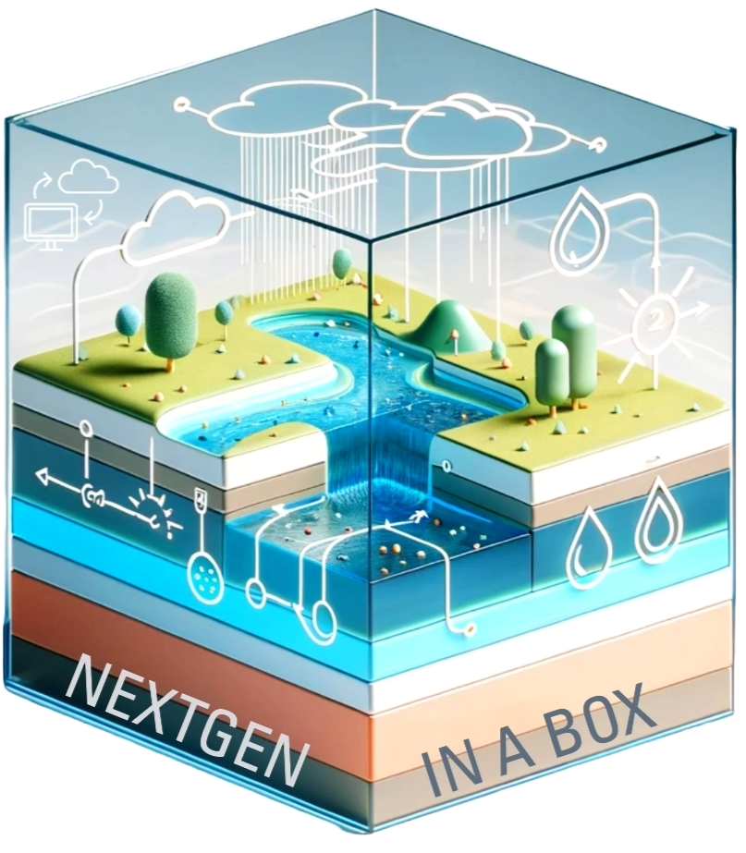
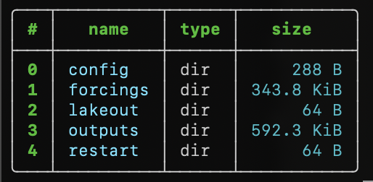
3
Prepare configuration and data inputs
Validation
Versioning
1
2
4
NGEN-DATASTREAM
ngen-datastream refers to the software chain that builds and validates NextGen input packages (ngen-run/), executes NextGen through NextGen In A Box (NGIAB), and versions the entire run for reproducibility.
This enforces a standard folder ngen-run/ which makes validation and versioning possible. A standard run folder also allows for other new tools to easily integrate with NGIAB (e.g., DataPreprocessor).

Slide 6
Prepare configuration and data inputs
1
Required steps to build ngen-run/config and ngen-run/forcings
Hydrofabric
Weights
Forcings
NEXTGEN BMI model configuration
GET
CALC
CALC
CALC
Defines spatial domain
Indices and coverage used to extract catchment averaged forcings
Performs conversion between National Water Model and NextGen forcings formats
Required files for NextGen BMI modules

Slide 7

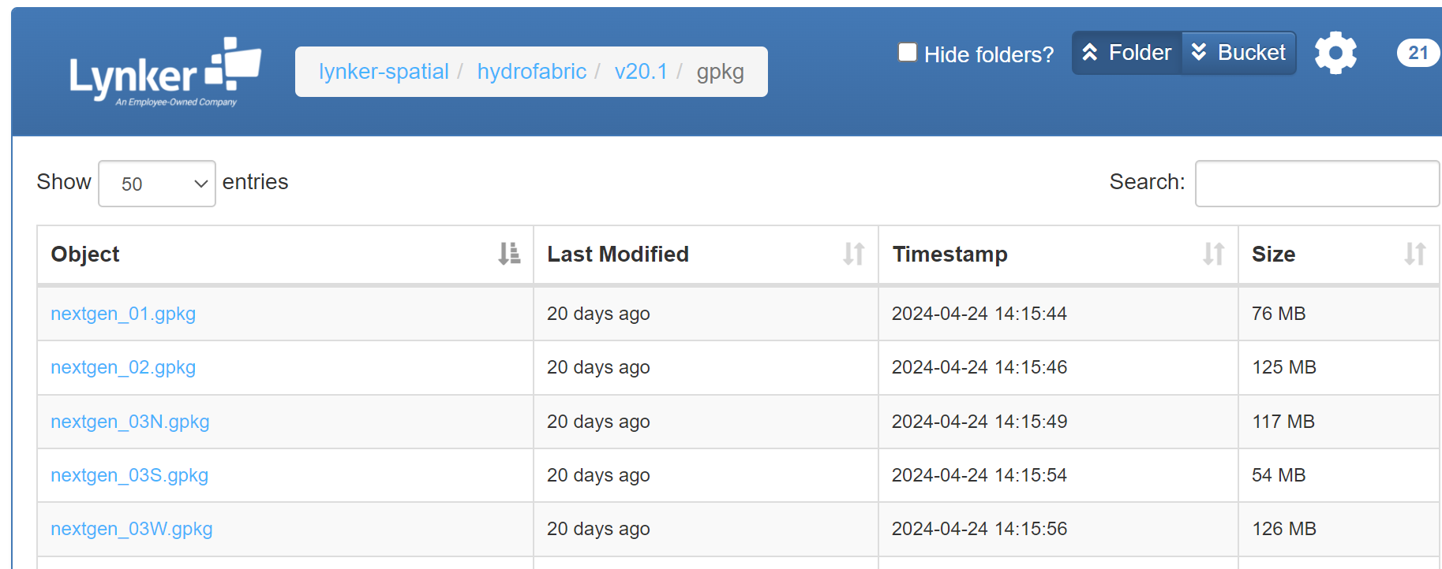
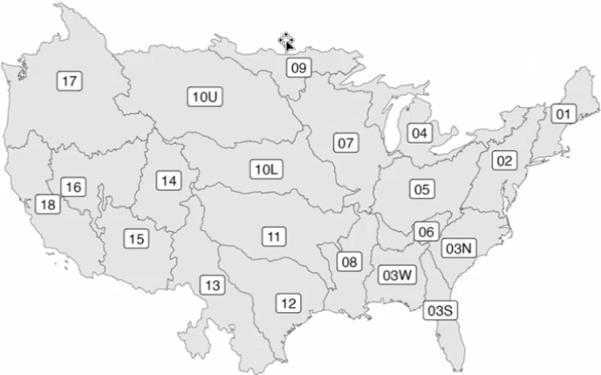
https://www.lynker-spatial.com/#hydrofabric/v20.1/gpkg/
Prepare configuration and data inputs
1
Hydrofabric
GET
Defines spatial domain

Slide 8
Prepare configuration and data inputs
1
“What if I want to define my own spatial domain?”
Do you know the catchment id you want to subset with?
Hydrofabric
Use the subsetting options!
hfsubset is integrated into ngen-datastream
GET
Defines spatial domain

Slide 9
Prepare configuration and data inputs
1
Required steps to build ngen-run/config and ngen-run/forcings
Hydrofabric
Weights
Forcings
NEXTGEN BMI model configuration
GET
CALC
CALC
CALC
Defines spatial domain
Indices and coverage used to extract catchment averaged forcings
Performs conversion between National Water Model and NextGen forcings formats
Required files for NextGen BMI modules

Slide 10

Index: 27463
Coverage: 75%
Prepare configuration and data inputs
1
Index: 27461
Coverage: 25%
Hydrofabric
Weights
GET
CALC
NWM
Defines spatial domain
Indices and coverage used to extract catchment averaged forcings
NGEN

Slide 11
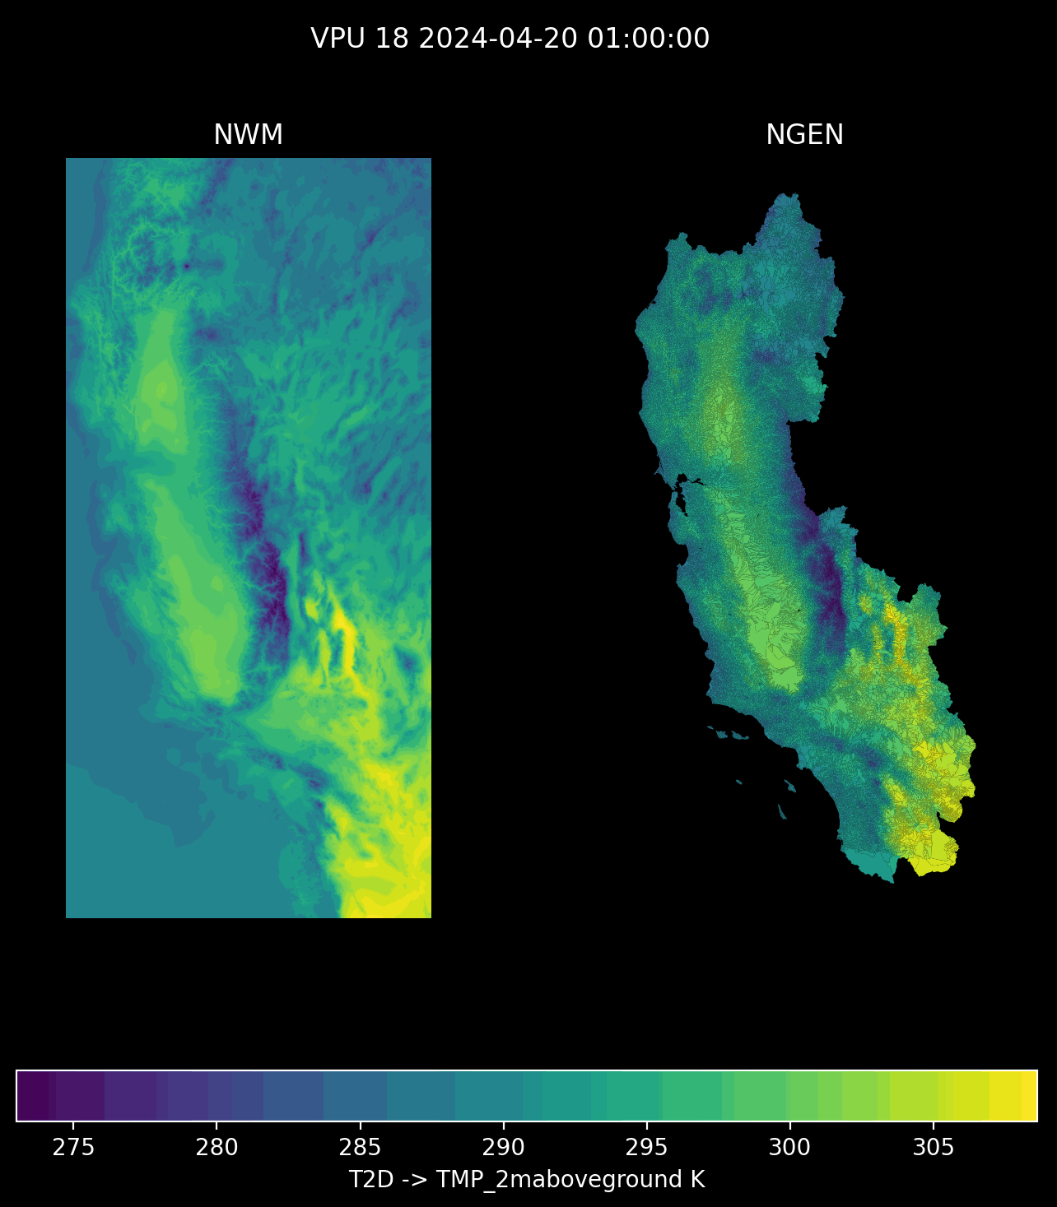
Prepare configuration and data inputs
1
Hydrofabric
Weights
Forcings
GET
CALC
CALC
Defines spatial domain
Indices and coverage used to extract catchment averaged forcings
Performs conversion between National Water Model and NextGen forcings formats

Slide 12
Prepare configuration and data inputs
1
Automatic BMI module detection from realization file
Hydrofabric
Weights
Forcings
NEXTGEN BMI model configuration
GET
CALC
CALC
CALC
Defines spatial domain
Indices and coverage used to extract catchment averaged forcings
Performs conversion between National Water Model and NextGen forcings formats
Required files for NextGen BMI modules
Supported BMI module config generation
PET, CFE, Noah-OWP-Modular, t-route
Coming soon
SoilFreezeThaw, TopModel, LSTM, others

Slide 13
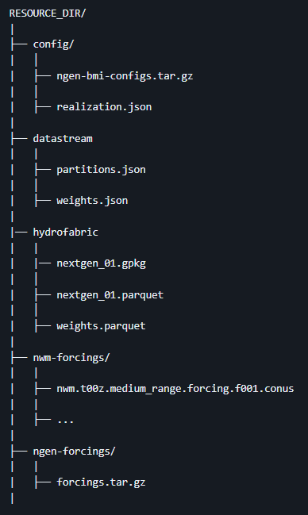
Weights and BMI model configuration generation are identical for a given spatial domain, hydrofabric version, and realization, meaning these files can often be reused. In addition, forcings can be reused if simulation start and end are static. Recycling these files via the resource directory can be thought of running ngen-datastream in “lite” mode.
Prepare configuration and data inputs
1
Hydrofabric
Weights
Forcings
NEXTGEN BMI model configuration
GET
CALC
CALC
CALC
Defines spatial domain
Indices and coverage used to extract catchment averaged forcings
Performs conversion between National Water Model and NextGen forcings formats
Required files for NextGen BMI modules
*SAVES MONEY*
https://github.com/CIROH-UA/ngen-datastream/tree/main?tab=readme-ov-file#resource_dir-datastream-resources

Slide 14
3
Prepare configuration and data inputs
Validation
Versioning
1
2
4
NGEN-DATASTREAM
ngen-datastream refers to the software chain that builds and validates NEXTGEN input packages (ngen-run/), executes NEXTGEN through NEXTGEN In A Box (NGIAB), and versions the entire run for reproducibility.
This enforces a standard folder ngen-run/ which makes validation and versioning possible. A standard run folder also allows for other new tools to easily integrate with NGIAB (e.g., DataPreprocessor).

Slide 15
NEXTGEN Water Modeling Framework Datastream Conceptual Model Breakdown
Validation
2
The value of the validation step is to notify the user of any errors in the NEXTGEN run package before beginning the execution
Coming soon -> BMI module variable mapping validation
Realization
Forcings
BMI configuration
Ensures the user has supplied a valid realization file to configure NEXTGEN
Ensures a forcing file exists for each catchment in the hydrofabric and for each time step specified in the realization
Ensures all BMI model configuration files exist.
Required for

Slide 16
3
Prepare configuration and data inputs
Validation
Versioning
1
2
4
NGEN-DATASTREAM
ngen-datastream refers to the software chain that builds and validates NEXTGEN input packages (ngen-run/), executes NEXTGEN through NEXTGEN In A Box (NGIAB), and versions the entire run for reproducibility.
This enforces a standard folder ngen-run/ which makes validation and versioning possible. A standard run folder also allows for other new tools to easily integrate with NGIAB (e.g., DataPreprocessor).

Slide 17
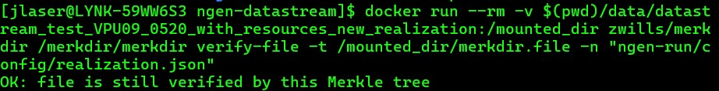
Versioning
4
4
Merkle Tree based hashing algorithm
“Root” hash allows for quickly identifying if two ngen-run directories are different.
Ability to query whether some file is a part of the tree represented by the root hash
Ability to compare files without opening them

Slide 18
3
Prepare configuration and data inputs
Validation
Versioning
1
2
4
NGEN-DATASTREAM
ngen-datastream refers to the software chain that builds and validates NEXTGEN input packages (ngen-run/), executes NEXTGEN through NEXTGEN In A Box (NGIAB), and versions the entire run for reproducibility.
This enforces a standard folder ngen-run/ which makes validation and versioning possible. A standard run folder also allows for other new tools to easily integrate with NGIAB (e.g., DataPreprocessor).

Slide 19
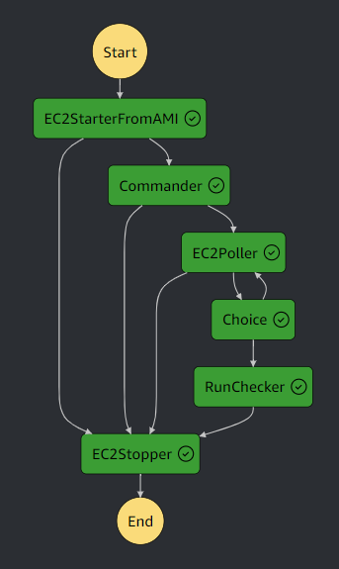
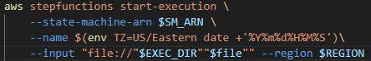
customize nextgen simulation resources in aws
ngen-datastream allows users to submit NextGen simulation jobs to cloud-based hosts in Amazon Web Services (AWS)
Users submit jobs via a customizable execution json to a generalizable AWS state machine that manages job execution
Customizable parameters in the execution json include:
Instance Type
Image Id
Number of instances
Volume Size
Region
Security Groups / Instance profile (IAM)
Commands
Terraform allows for quick building of complex AWS infrastructure
Allows users to access HPC resources
Highly configurable execution file allows users to finely tune resources to their ngen executions

Slide 20
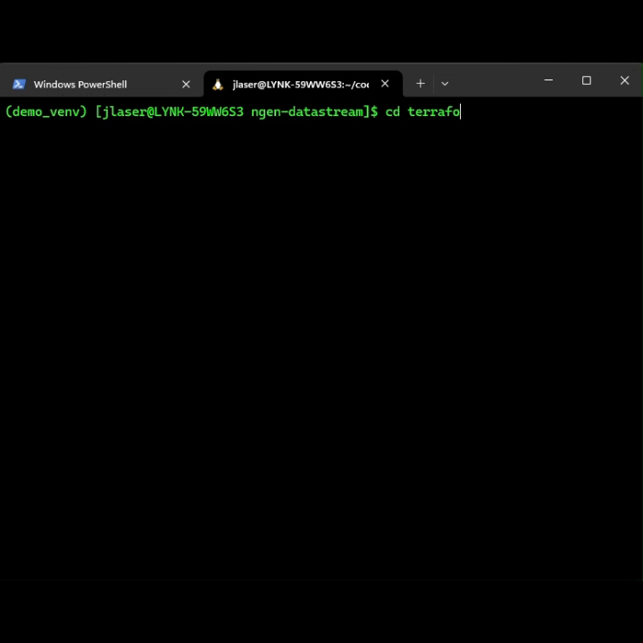
Terraform
Terraform (IaC) builds the AWS state machine
Build the cloud infrastructure with terraform init, plan, and apply
Edit the execution json to use an AWS Machine Image built from an ec2 with ngen-datastream installed. Set desired options
Submit job to AWS state machine via awscli
Takeaways:
Terraform allows for quick building of complex AWS infrastructure
Allows users to access HPC resources ($$)
Highly configurable execution file allows users to finely tune resources to their ngen executions

Slide 21
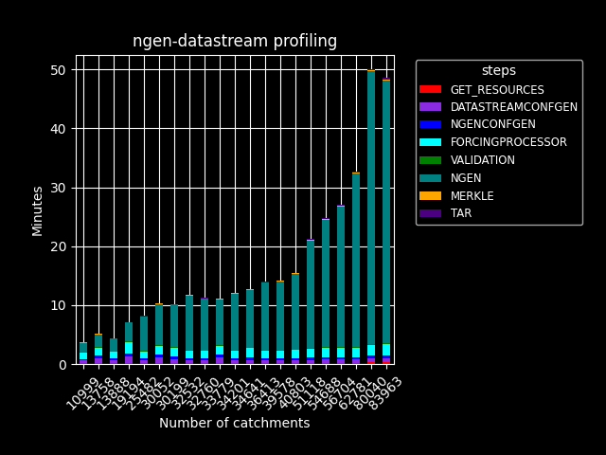
Research datastream in aws cloud
Split VPU daily run - An application of the ngen-datastream AWS state machine
24-hour CONUS NextGen simulation scheduled each day with AWS EventBridge
22 individual ec2 instances, 1 for forcingprocessor , 21 simultaneously processing for each VPU
CONUS runtime determined by the runtime of the largest VPU.

Slide 22
usage
Be aware of your resources constrains (CPU, Memory, Network)
In general, ngen-datastream memory footprint scales with
Number of catchments (size of the spatial domain)
Number of time steps (Simulation duration / output_interval)
If a crash is experienced, either increase the host resources or decrease one or both above dimensions
Linux commands to monitor resources
Watch memory usage -> free –h –s2
Watch processes/cpu usage -> top
Check available processes -> nprocs
https://github.com/CIROH-UA/ngen-datastream/blob/main/USAGE.md

Slide 23
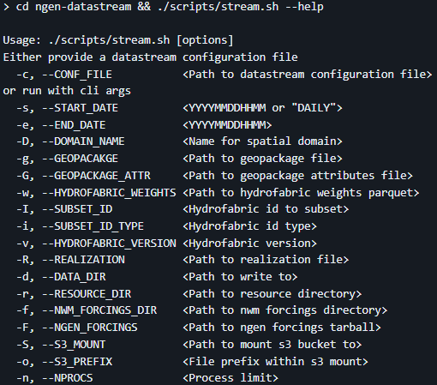
options
See the README.md in the repo for an explanation of each variable
simulation start and end
spatial domain
NextGen configuration
ngen-datasteam “lite”
RUN options
AWS s3 mount

Slide 24
workshop
https://github.com/CIROH-UA/ngen-datastream/blob/main/docs/CIROH_devcon_2024/workshop.md

Slide 25
Take-aways
ngen-datastream automates the process of collecting and formatting input data for NextGen, orchestrating the NextGen run through NextGen In a Box (NGIAB), and handling outputs. This software allows users to run NextGen in an efficient, relatively painless, and reproducible fashion.
Flexibility in the design allows users to provide their own files if desired.
Scalability via AWS state machine gives users access to HPC resources.
Collaborative process! Feel free to contact me with questions

Slide 26
Future work
CI/CD
Feedback/Collaboration with community
Realization BMI module variable mapping validation
Expand terraform to include more cloud providers
Expand modules ngen-datastream is aware of
Begin the science!
Find regional improvements to NextGen realization

Slide 27
Terms
Catchment – geographic area characterized by a single location, a nexus, where all precipitation in the area runs off through. A drainage basin.
Nexus – the singular point where water flows into or out of a catchment. Often a point along a river.
Subsetting – To reduce a large geopackage (many catchments) down to a smaller geopackage (fewer catchments) . In effect, this is choosing the domain over which ngen will run.
Hashing – SHA256 algorithm applied to files to generate a unique id for a file. Useful for preserving and distinguishing unique inputs.
Validation – Ensuring the ngen input directory data_dir has been constructed properly. Properly meaning that NextGen will not crash and will generate output data.

Slide 28
Acronyms
NWM – National Water Model
NGIAB – Next Generation National Water Model in a Box
NGEN/NEXTGEN - Next Generation National Water Model
IaC – Infrastructure as code
VPU – Vector Processing Unit
CFE – Conceptual Function Equivalent
PET – Potential Evapotranspiration
NOM – NOAA-OWP-Modular
OWP – Office of water prediction
BMI – Basic Model Interface

Slide 29
links
ngen-datastream
https://github.com/CIROH-UA/ngen-datastream/tree/main
Forcingprocessor
https://github.com/CIROH-UA/ngen-datastream/tree/main/forcingprocessor
Validation
https://github.com/CIROH-UA/ngen-datastream/blob/main/python/README.md
https://github.com/NOAA-OWP/ngen-cal
https://github.com/CIROH-UA/ngen-datastream/blob/main/python/src/datastream/run_validator.py
NextGen BMI module config generation
https://github.com/CIROH-UA/ngen-datastream/blob/main/python/src/datastream/ngen_configs_gen.py
Hydrofabric Subsetting
https://github.com/LynkerIntel/hfsubset
Versioning
https://github.com/makew0rld/merkdir
NGIAB
https://github.com/CIROH-UA/NGIAB-CloudInfra
ngen-datastream AWS state machine
https://github.com/CIROH-UA/ngen-datastream/tree/main/terraform
https://docs.ciroh.org/
https://github.com/NOAA-OWP/ngen/wiki
https://ciroh.ua.edu/

